Slide 1
Text Summarization using Neural Networks

Slide 2
Text Summarization Types:
Extractive:
copying parts of the source text through some measure of importance and then combine those part/sentences together to render a summary.
Abstractive:
generate new phrases, possibly rephrasing or using words that were not in the original text.

Slide 3
Extractive Summarization

Slide 4
Extractive Approaches:
- Feature Engineering-based approach.
- Data Driven Approach.

Slide 5
Feature Engineering-based Approach

Slide 6
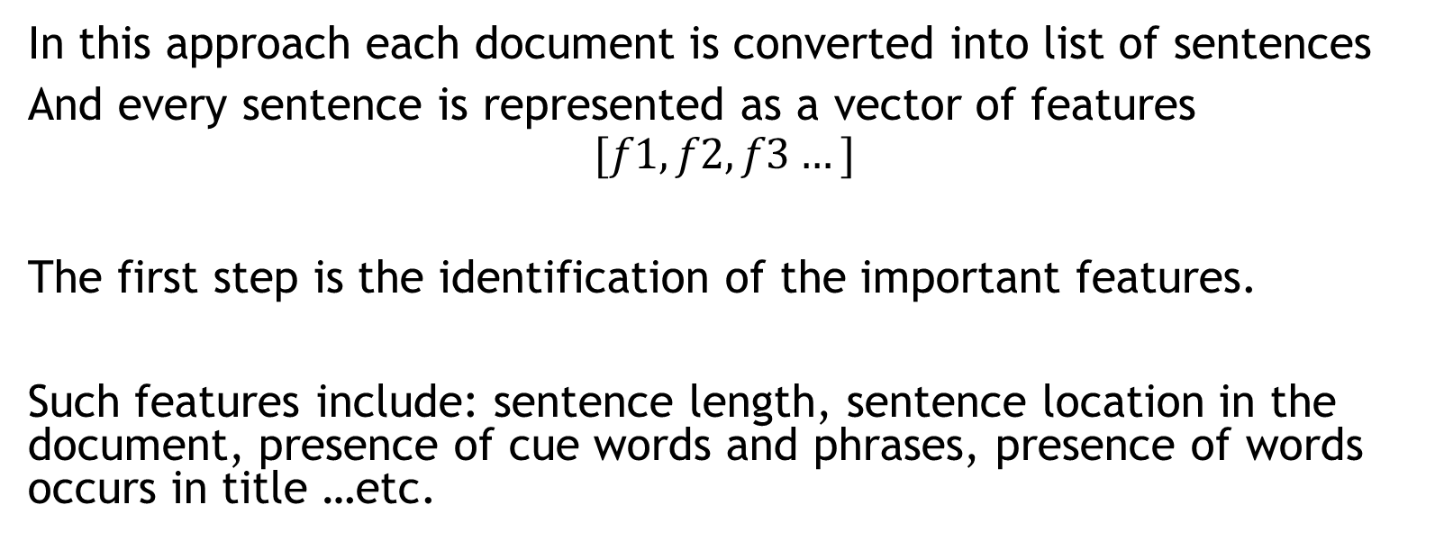
Feature Engineering-based Approach
In this approach each document is converted into list of sentences
And every sentence is represented as a vector of features
$$[f1,f2,f3…]$$
The first step is the identification of the important features.
Such features include: sentence length, sentence location in the document, presence of cue words and phrases, presence of words occurs in title …etc.

Slide 7
feature | Discription
F1 | Paragraph follow title
F2 | Paragraph location in document
F3 | Sentence location in paragraph
F4 | First sentence in paragraph
F5 | Sentence length
F6 | Number of title words in sentence
f7 | Number of thematic words in sentence

Slide 8
Feature Engineering-based Approach
There are three phases to this approach:
1- neural network training
2- features fusion
3-Sentence selection.

Slide 9
1-neural network training
We train the network with sentences in several test paragraph
Where each sentence is identified whether it should be in the summary or not.
We use a three layered feedforward network

Slide 10

1-neural network training
We use gradient method to train the network where the energy function is a combination of error function and a penalty function
The addition of the penalty function drives the associated weights
Of unnecessary connection to a very small values, while strengthening the rest of the connections, therefore the unnecessary connections and neurons can be pruned without a affecting the network performance
The goal of training is to search for a global minimum of the energy function
The energy function:

Slide 11

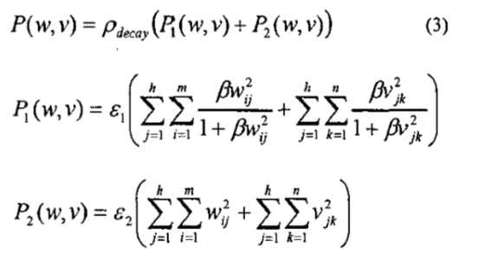
1-neural network training
The error function:
The penalty function:

Slide 12
2-features fusion:
A- eliminating the uncommon feature.
B- collapsing the effects of common features.

Slide 13
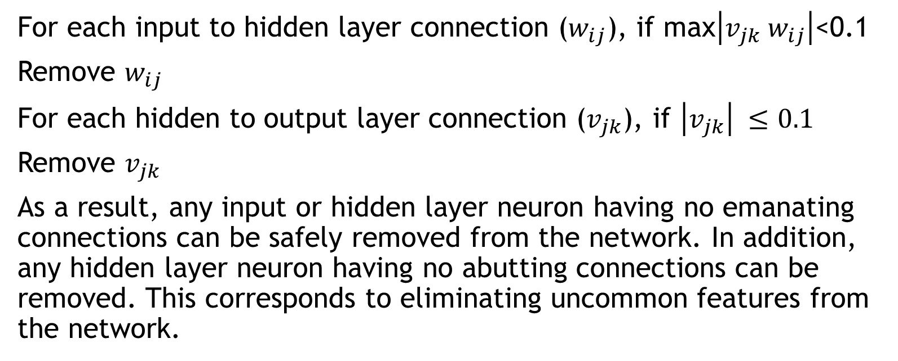
A. Eleminating the uncommon features
For each input to hidden layer connection ($w_{ij}$), if max$\left|v_{jk} w_{ij}\right|$<0.1
Remove $w_{ij}$
For each hidden to output layer connection ($v_{jk}$), if $\left|v_{jk}\right| ≤0.1$
Remove $v_{jk}$
As a result, any input or hidden layer neuron having no emanating connections can be safely removed from the network. In addition, any hidden layer neuron having no abutting connections can be removed. This corresponds to eliminating uncommon features from the network.

Slide 14
A. Eliminating the uncommon features
Once the pruning step is complete, the network is trained with the same dataset in phase one to ensure that the recall accuracy of the network has not diminished significantly. If the recall accuracy'of the network drops by more than 2%, the pruned connections and neurons are restored and a stepwise pruning approach is pursued. In the stepwise pruning approach, the incoming and outgoing connections of the hidden layer neurons are pruned and the netwok is re-trained and tested for recall accuracy, one hidden layer neuron at a time.

Slide 15

B. Collapsing the effects of common features
After pruning the network, the hidden layer activation values for each hidden layer neuron are clustered utilizing an adaptive clustering technique, where G, is the centroid of cluster c.
The clustering function:

Slide 16
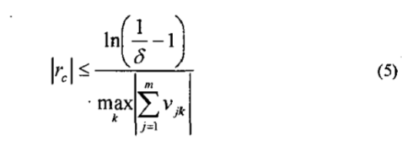
B. Collapsing the effects of common features
The clustering algorithm is adaptable that is the clusters are created dynamically as activation values added into the clusters.
Therefore the number of clusters and the numbers of activation values in each cluster are known prior to clustering algorithm
In the sentence selection phase the activation value of each hidden layer neuron is replaced by the centroid of the cluster which the activation value belong to
The performance of the network is not compromised as long as the cluster radius is less than the following upper bound where the error tolerance is usually set to a value less than 0.01

Slide 17
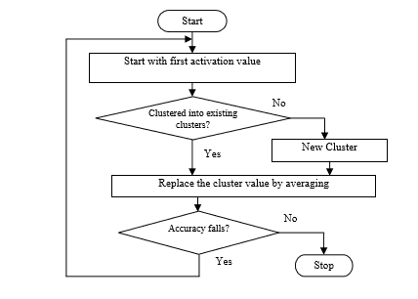
The clustering algorithm flowchart

Slide 18
3- Sentence selection
After finishing training the network we choose the sentences with the highest ranking to include them in the summary

Slide 19
Data Driven Approach

Slide 20
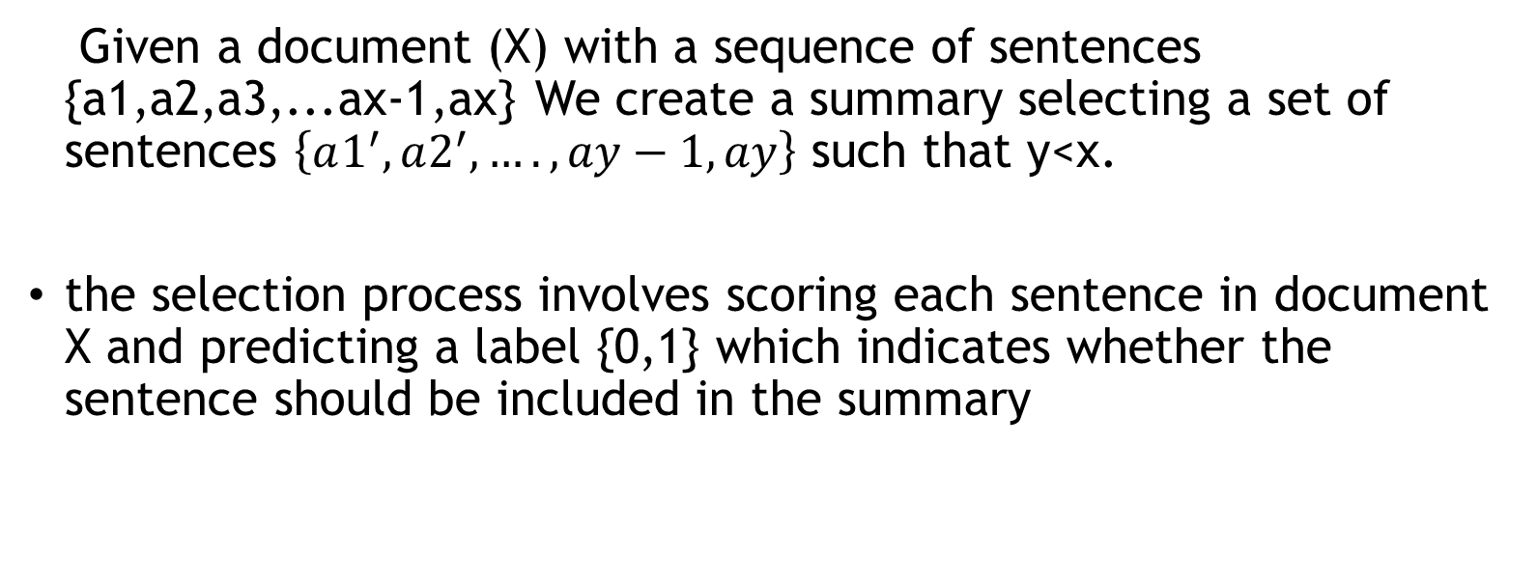
Problem formulation
Given a document (X) with a sequence of sentences {a1,a2,a3,...ax-1,ax} We create a summary selecting a set of sentences $\left\{a1^{′}, a2^{′},….,ay−1,ay\right\}$ such that y<x.
the selection process involves scoring each sentence in document X and predicting a label {0,1} which indicates whether the sentence should be included in the summary

Slide 21
Proposed Model
The model consists of a neural network with one input layer, one hidden layer, one output layer.
Since the input to the neural networks has to be numbers, the sentences have to be converted and represented in some numerical form.
We use word2vec to convert the words of the sentences to vectors form.

Slide 22
Word2vec
Word2Vec is a group of related models that are used to produce vector representations of words called “word embeddings”
It has two model architectures :
Continuous Bag-of-Words model (CBOW): predicts target words from source context words.
Skip-Gram model: predicts source context-words from the target words.

Slide 23
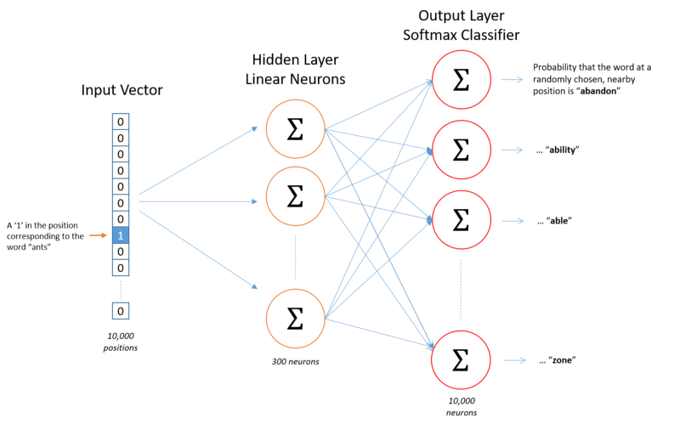
Skip-gram model architecture

Slide 24
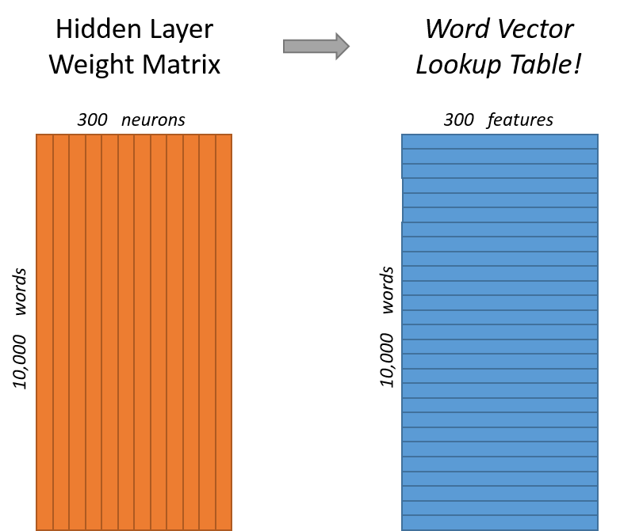

Slide 25
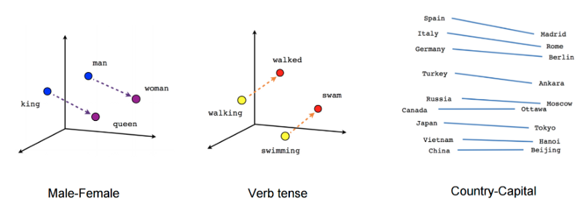

Slide 26
Sentence representation
we use the Fasttext library provided by Facebook to convert our sentences to vectors. The model takes input as sentences of the English language, vector representation of words and converts the sentences to fixed dimension vectors (100 in our case).

Slide 27
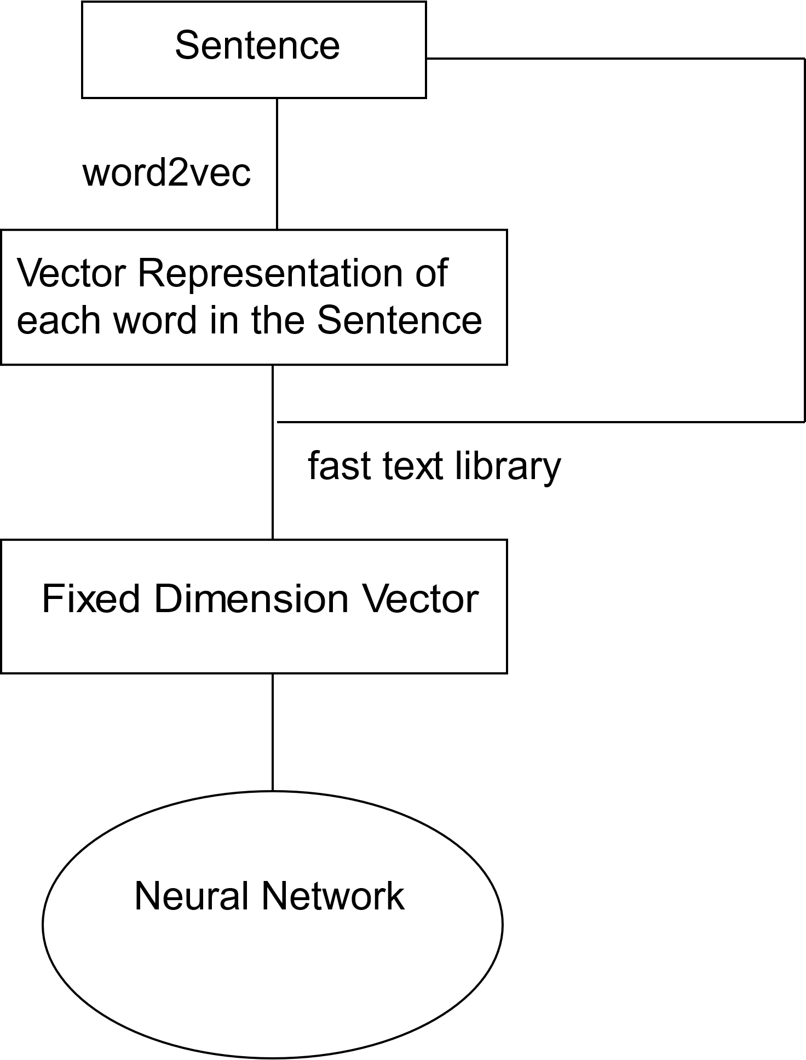

Slide 28
Generalizing the input
one problem that still remains is that of variation in length of documents. Every document has different length in terms of the number of sentences.
Let the number of sentences in the document be ‘doc_len’
we divide the document into ‘pages’, each having a fixed
number of sentences (page-len)

Slide 29
Generalizing the input
for each run of the network sentences of a page are converted into their corresponding vectors (each having 100 entries).
All such vectors are concatenated in order to form a page_len*100 dimension vector which is fed to the input layer of the network

Slide 30
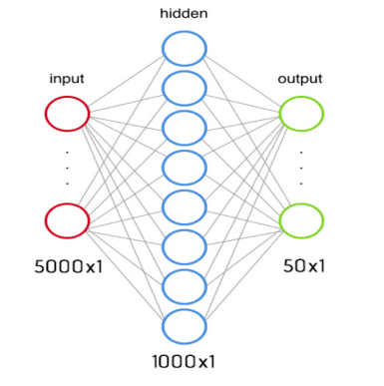

Slide 31
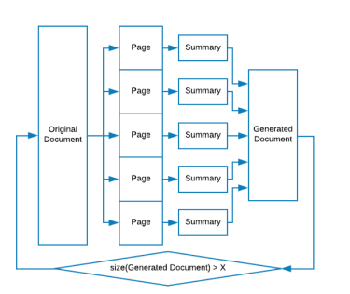

Slide 32
The output
A softmax activation function is applied to the output at the last layer.
Each entry of the obtained vector denotes the weight associated with the corresponding sentence which represents the measure of belief of the sentence being included in the summary

